Slide 1

30 Days Data Scinece & Analytics Master Class
Day1 : Python for Data Science
Time: 6.00 PM IST
Free Registration

Slide 2
30 Days Data Scinece & Analytics Master Class
Handbook

Slide 3
NANDHINI.S
Exp: 5 Yrs
Expert in
Python Developer on Machine Learning
Deep learning with computer vision
Matlab – Image Processing
Autonomous Car design using ROS with LIDAR
Language – Python , Java , HTML ,CSS.
Tools – ANACONDA NAVIGATOR, JUPYTER NOTEBOOK,
GOOGLE COLAB.
Graduation : BE – ECE | 2011

Slide 4
Pantech?
Educational Equipment Manufacturer
IoT, AI, Robotics,Autonomous Robot
Microprocessor/Microcontroller
DSP,VLSI, Embedded System
Power Electronics & Drives, Fuel Cell Trainer Kit
Renewable Energy Lab, Electric Vehicle Lab
Technical Training
DIY Project

Slide 5

What is Master Class ?
👍 This is the 30 Days Industrial Learning Activity.
👍 Its Online YouTube Live Class
👍 If you Invest 45 minutes daily, U will become Master in Data Science
👍 You will get FREE E-Certificate
Webinar Participation Certificate
“Learning is the beginning of wealth.
Searching & Learning is where the miracle process all begins.” …………….Jim Rohn

Slide 6
Our Vision
Help 10 Million Students to Learn the Technology in Easy Way

Slide 7

Associate Partner for this Master Class
https://apssdc.in/home/

Slide 8
What U will Learn from 30 Days Data Science & Analytics Master Class

Slide 9
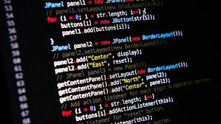
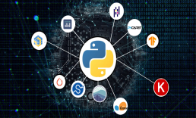

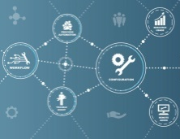
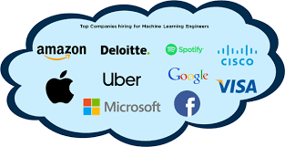
Data Science & Analytics Learning Plan
01
02
03
04
05
Library
Python
Analytics
Tools
Industry Project
Introduction To Python and Python Data Structures
Pandas
Numpy
MatplotLib
Cborn, SKLearn Lib
Collab
Distribution
Visualization
Aggregation
Statistics
PowerBi
Tableo
Project Building,
DSA Jobs

Slide 10
Day wise Learning Plan
Day -1 : Python for Data Science (5 Solved end-to-end Data Science Projects in Python)
Day -2: Advanced Python Programming
Day -3: Pandas Library – Introduction
Day -4: Pandas Library – Data Structures
Day -5: Numpy library – Array Operations | Mathematical Functions
Day -6: Numpy – Sort, Search and Counting Functions
Day -7: Matplotlib , Histogram Using Matplotlib | I/O With Numpy
Day -8: Matplotlib Library – Introduction , Pyplot API | Types Of Plots
Day -9: Seaborn Library
Day -10: SKLearn Library
Day -11: Google Colab Notebook
Day -12: Python – Date and Time, Data Wrangling
Day -13: Python – Data Aggregation
Day -14: Python – Word Tokenization , Stemming and Lammetization
Day -15: Python – Data Visualization

Slide 11
Day wise Learning Plan
Day -16: Python – Statistical Analysis
Day -17: Python – Types Of Distribution
Day -18: Python – Correlation ,Chi-Square Test , Linear Regression
Day -19: Tableau – Introduction and Tools
Day -20: Tableau – Data Sources , Worksheets
Day -21: Spatial Data Science For Covid-19 Disease Prediction
Day -22: Power-BI – Introduction, Installation Steps and Architecture
Day -23: Power-BI – Data Modelling , Visualization Options | Excel Integration
Day -24: Parkinson’s Disease Prediction – XG Boost Classifier
Day -25: House Price Prediction using Random Forest Regression
Day -26: Customer Segmentation Using ML – K-Means Clustering
Day -27: Home Loan Prediction using Decision Tree Classifier
Day -28: Spam Classification using NLP
Day -29: Hand Written Digit Recognition Using CNN
Day -30: Churn Prediction using Deep Learning

Slide 12
List of Projects for Demo in YouTube Live
Spatial Data Science For Covid-19 Disease Prediction
Parkinson’s Disease Prediction-XGBoost Classifier
House Price Prediction-Random Forest Regression
Customer Segmentation Using ML-K-Means Clustering
Home Loan Prediction-Decision Tree Classifier
Spam Classification-NLP
Hand Written Digit Recognition Using Python-CNN
Churn Prediction-Deep Learning
Crop Yield Prediction
Ground water level prediction
All Projects in Jupyter Notebook

Slide 13
What you will get from this Free 30 Days Master Class?
You can attend YouTube Live Class
Free E-Certificate ( WEBINAR PARTICIPATION CERTIFICATE)

Slide 14
How to mark your Attendance in YouTube Live Class?
Ans : During the Live Class, organizer will post Google Form link in Live Chat. The Participants should submit the from on daily basis. Minimum 25 Days Attendance is Required to get Free Master Class Participation Certificate.
Note : The Link will be available during the Live. From the LIVE Class date, the live video will get removed from the YouTube in 3 days.

Slide 15
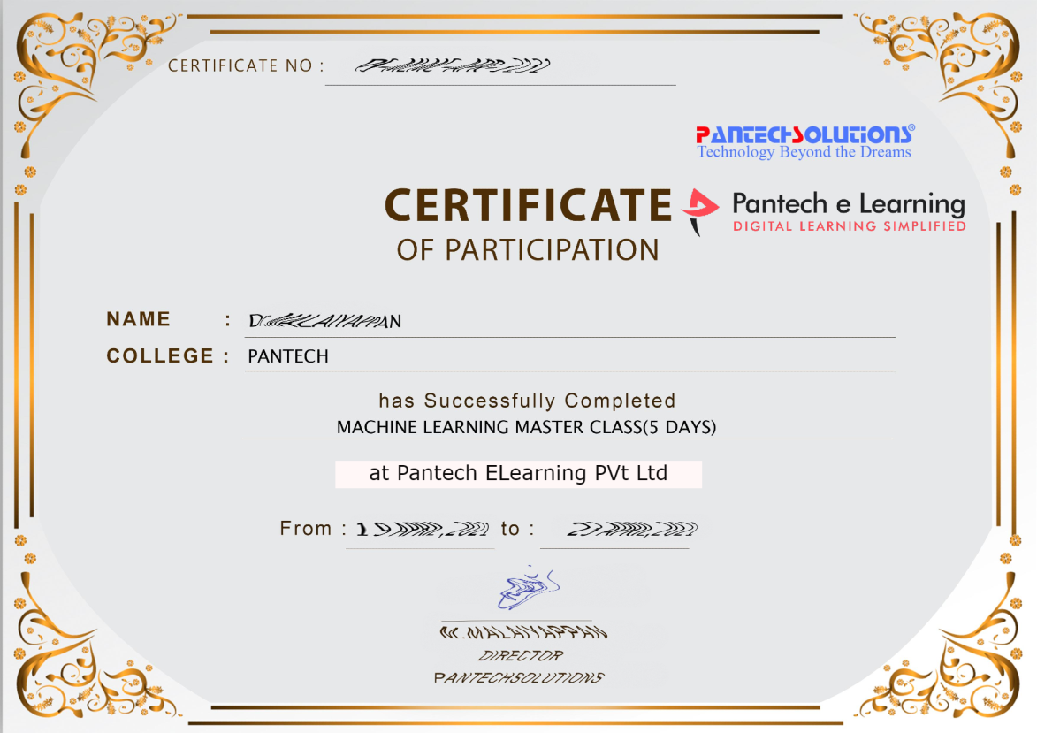

Sample Webinar Participation Certificate?

Slide 16
https://www.pantechelearning.com/data-science-master-class/
On Demand
You can get chance to apply 1 Month Internship on Data Science & Analytics Master Class

Slide 17
What is Internship????
Learn
Practice
Verify
Get Certified
Grow

Slide 18
Free Master Class DSA | 1 Month Internship on DSA
Master Class Participation Certificate | Internship Completion Certificate
Minimum 25 Class should attend YouTube Live | Recorded Class Link will be provided. – LMS Portal Access
YouTube Live Mandatory | Your Choice. You can attend Live or else You can watch Recorded Class in LMS Portal
All Projects Demo class in YouTube Live | Step by Step Video Explanation Content in LMS Portal
Access : 3 Days | VIP WhatsApp Group Support
 | You Can Download All PPTs
 | 4 Nos of Hackathon Class in Zoom Live. The Recording also will be provided
 | You Can Download All Project Files
 | Mentor will guide you to finish 10 Projects
 | Access : 60 Days

Slide 19
Pantech will make you to Create 10 Projects in Data Science & Analytics in 30 Days
Objective of this 30 Days Master Class

Slide 20
1 Month Internship in Data Science
INTERNSHIP E-Certificate(30Days Internship on Data Science Engineering)
Highly organized Video content
Download All Files
Download PPTs
Assignments
Flexible Time.
Access Period: 60Days from the date of payment

Slide 21
What You Will Get???
Complete Project Files
30 Days Learning Activity
Data Science Core Concepts
10 + Projects
Project PPT
Spatial Data Science For Covid-19 Disease Prediction
Parkinson’s Disease Prediction-XGBoost Classifier
House Price Prediction-Random Forest Regression
Customer Segmentation Using ML-K-Means Clustering
Home Loan Prediction-Decision Tree Classifier
Spam Classification-NLP
Hand Written Digit Recognition Using Python-CNN
Churn Prediction-Deep Learning
Crop Yield Prediction
Ground water level prediction
Video Class Access for 2 Months
Get chance to Enroll 1-Month Internship on demand

Slide 22
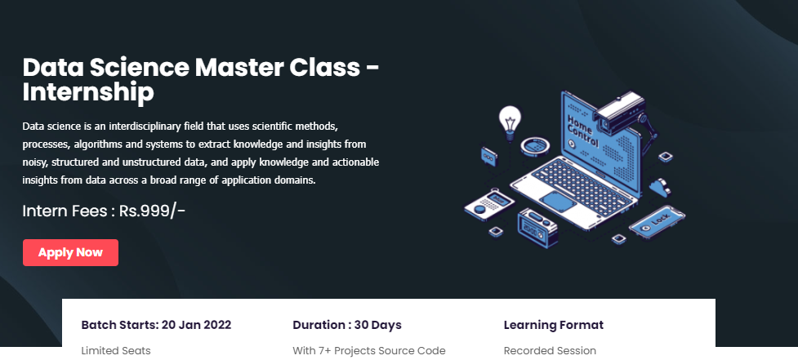
How to join in 1 month Internship
https://www.pantechelearning.com/data-science-master-class/
Click Here
Coupon Code: DSABATCH2

Slide 23
Python – Date and Time
In data science , we need analysis which is based on temporal values.
Python can handle various formats of date and time.
The datetime library provides the essential methods and functions.
Date Time Representation
Date Time Arithmetic
Date Time Comparison

Slide 24
Python – Date Time Representation
A date and its various parts are represented by different datetime functions.
Format specifiers are used to display the alphabetical parts of a date like name of the month or week day.

Slide 25
Python – Date Time Representation
import datetime
print ('The Date Today is :', datetime.datetime.today())
date_today = datetime.date.today()
print (date_today)
print ('This Year :', date_today.year)
print ('This Month :', date_today.month)
print ('Month Name:',date_today.strftime('%B'))
print ('This Week Day :', date_today.day)
print ('Week Day Name:',date_today.strftime('%A'))

Slide 26
Date Time Representation - Output
The Date Today is : 2018-04-22 15:38:35.835000
2018-04-22
This Year : 2018
This Month : 4
Month Name: April
This Week Day : 22
Week Day Name: Sunday

Slide 27
Python – Date Time Arithmetic
In order to do various operations related to dates , the dates are stored in different variables.
Then , the relevant mathematical operator are applied to those variables.

Slide 28
Python – Date Time Arithmetic
import datetime
#Capture the First Date
day1 = datetime.date(2018, 2, 12)
print ('day1:', day1.ctime())
# Capture the Second Date
day2 = datetime.date(2017, 8, 18)
print ('day2:', day2.ctime())
# Find the difference between the dates
print ('Number of Days:', day1-day2)

Slide 29
Python – Date Time Arithmetic
date_today = datetime.date.today()
# Create a delta of Four Days
no_of_days = datetime.timedelta(days=4)
# Use Delta for Past Date
before_four_days = date_today - no_of_days
print ('Before Four Days:', before_four_days )
# Use Delta for future Date
after_four_days = date_today + no_of_days
print ('After Four Days:', after_four_days )

Slide 30
Date Time Arithmetic - Output
day1: Mon Feb 12 00:00:00 2018
day2: Fri Aug 18 00:00:00 2017
Number of Days: 178 days, 0:00:00
Before Four Days: 2018-04-18
After Four Days: 2018-04-26

Slide 31
Output
day1: Mon Feb 12 00:00:00 2018
day2: Fri Aug 18 00:00:00 2017
Number of Days: 178 days, 0:00:00
Before Four Days: 2021-12-12
After Four Days: 2021-12-20

Slide 32
Python – Date Time Comparison
Date and time are compared using logical operators.
One must be careful in comparing right parts of the dates with each other.

Slide 33
Date Time Comparison
import datetime
date_today = datetime.date.today()
print ('Today is: ', date_today)
# Create a delta of Four Days
no_of_days = datetime.timedelta(days=4)
# Use Delta for Past Date
before_four_days = date_today - no_of_days
print ('Before Four Days:', before_four_days)
after_four_days = date_today + no_of_days
date1 = datetime.date(2018,4,4)

Slide 34
Date Time Comparison
print ('date1:',date1)
if (date1 == before_four_days):
print ('Same Dates’)
if (date_today > date1):
print ('Past Date’)
if (date1 < after_four_days):
print ('Future Date‘)

Slide 35
Date Time Comparison - Output
Today is: 2018-04-22
Before Four Days: 2018-04-18
date1: 2018-04-04
Past Date
Future Date

